Slide 1
Status Report #22
2020. 04. 10 (Fri)
M1 FUJIWARA Tomasa

Slide 2
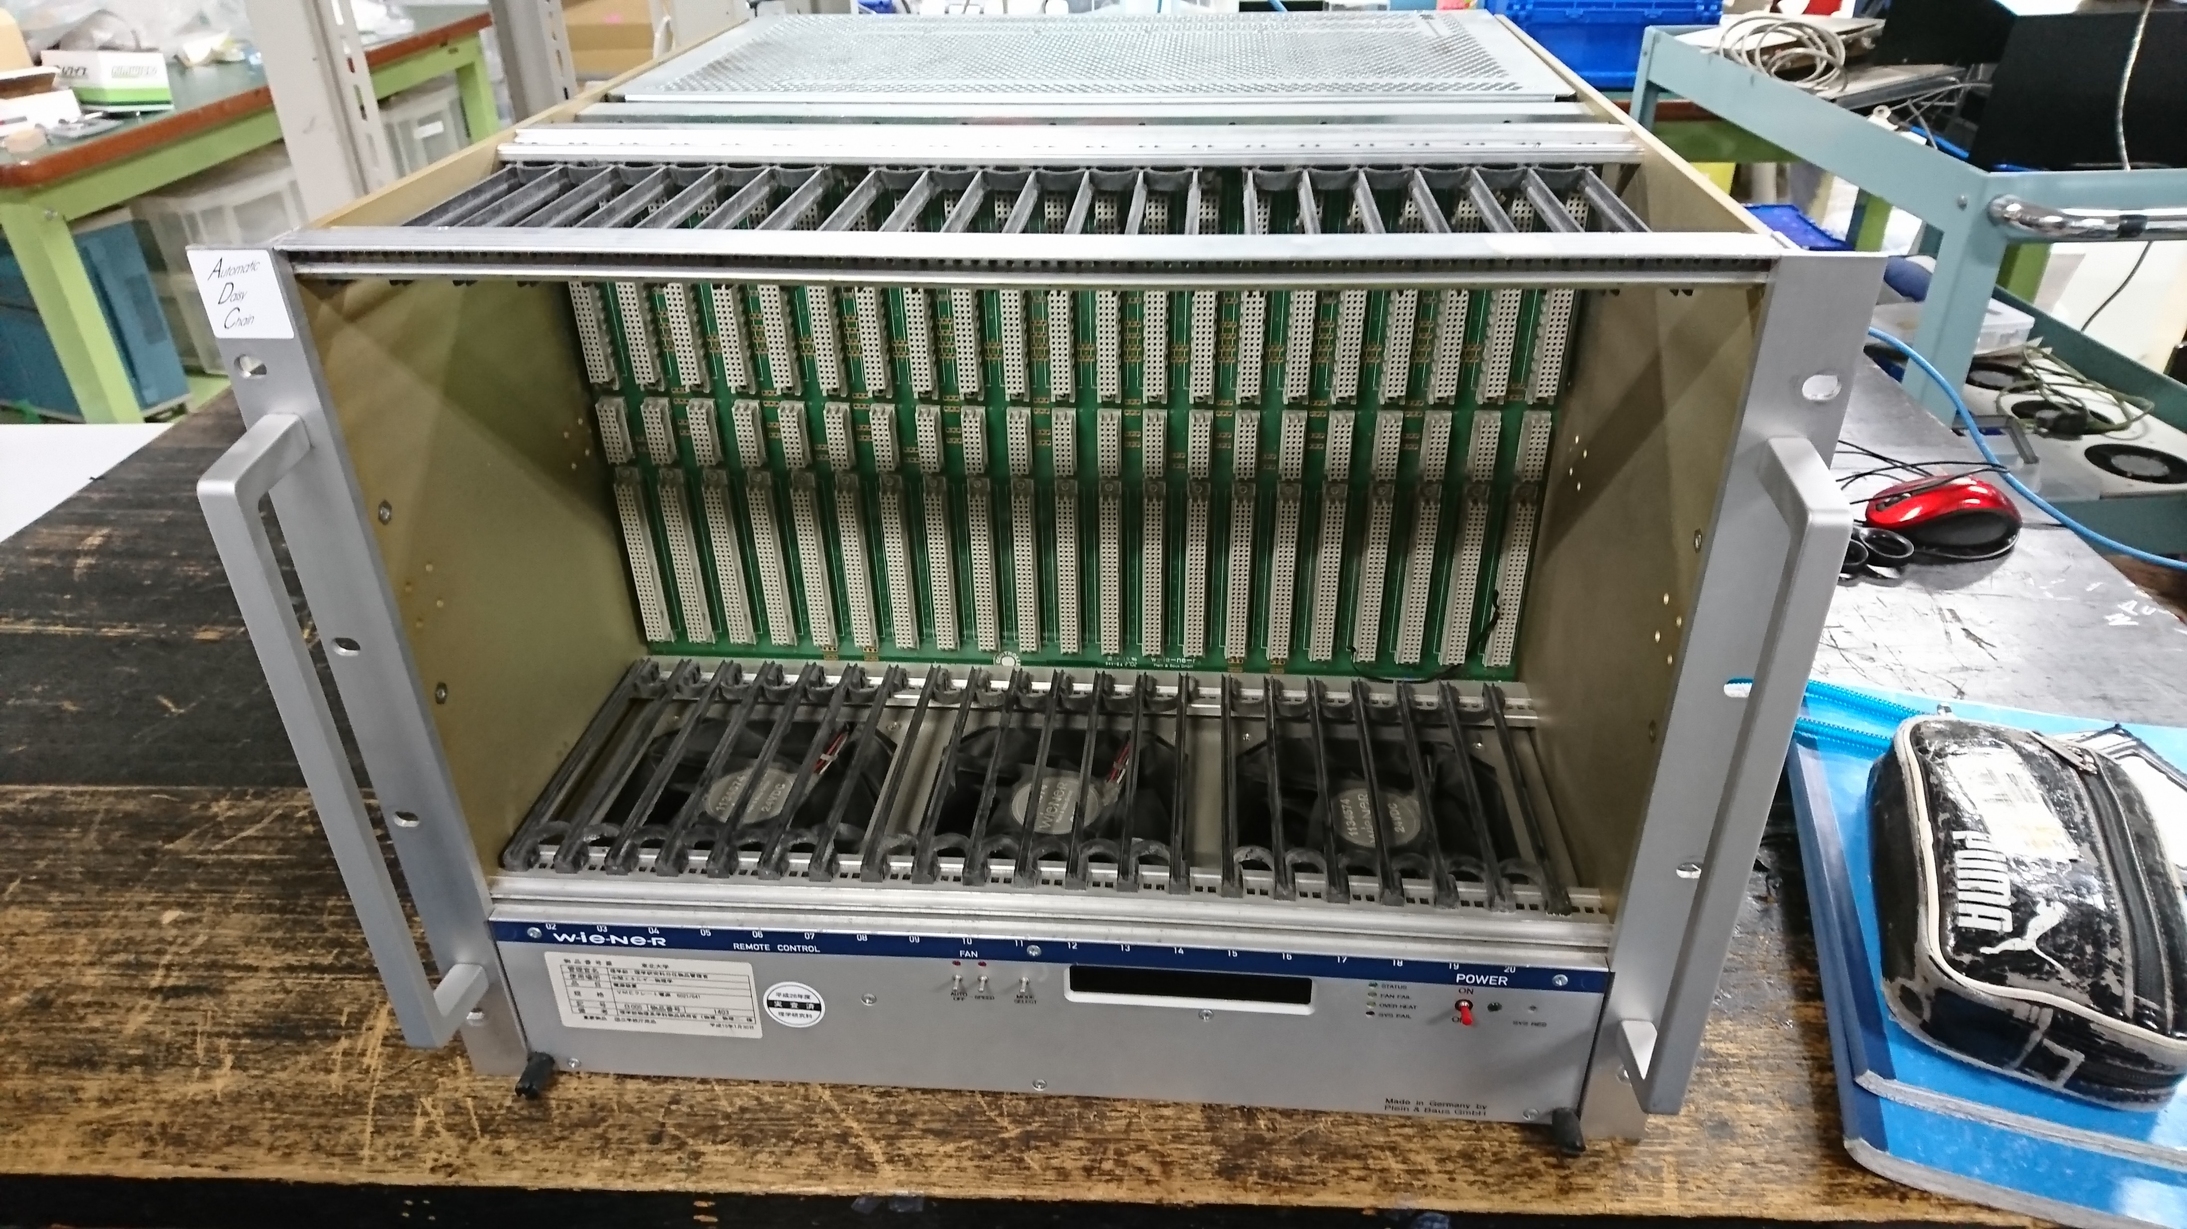
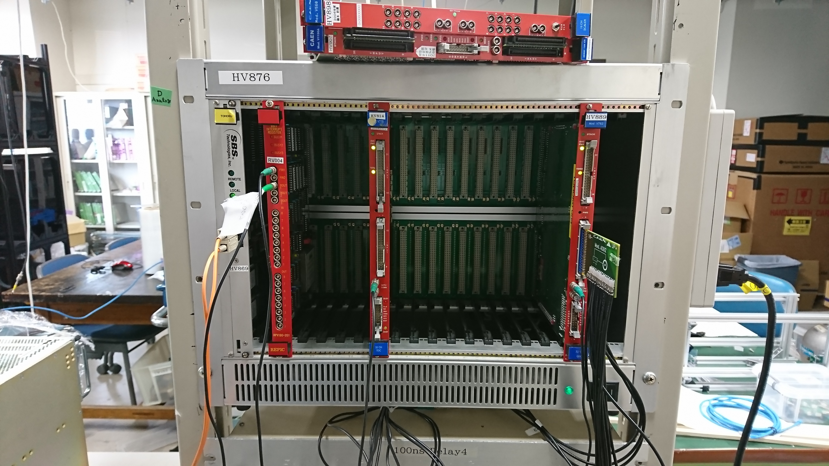
Testbench moving
ToF testbench at rm.635 → rm.637 because of rm.635 shutdown
物品の移動にご協力いただき本当にありがとうございました.
Accident: VME crate was broken
移動後に再度電源を入れようとしたところつかなくなっていました...(下図左)
チェンバー部屋からもう一台持ってきて対応(下図右) → 現在はこちらを使用中.

Slide 3
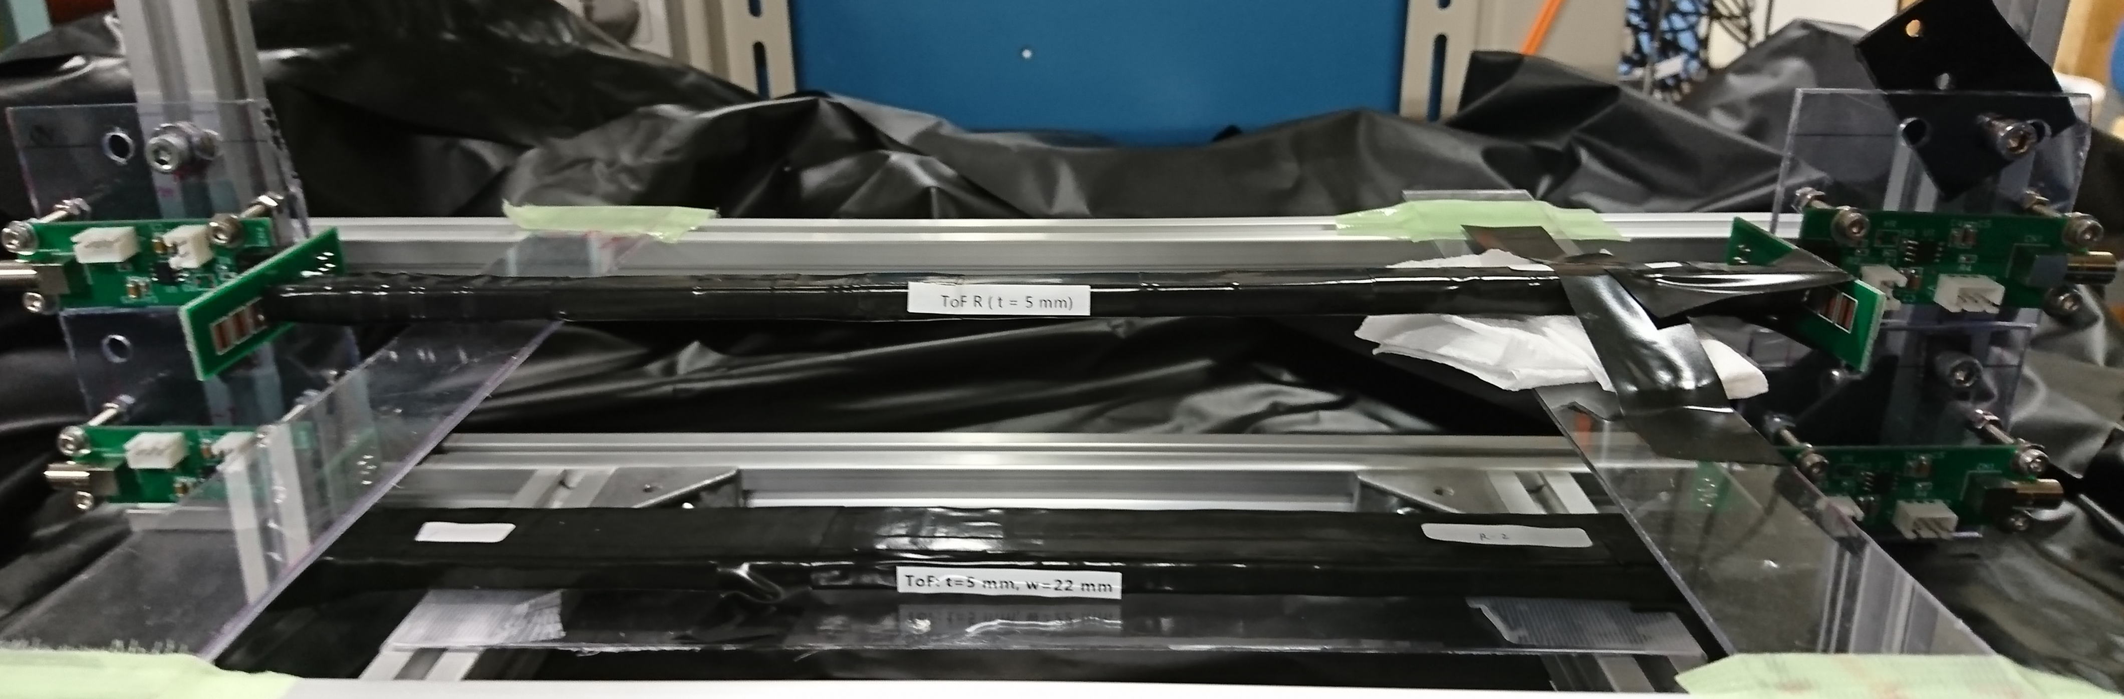
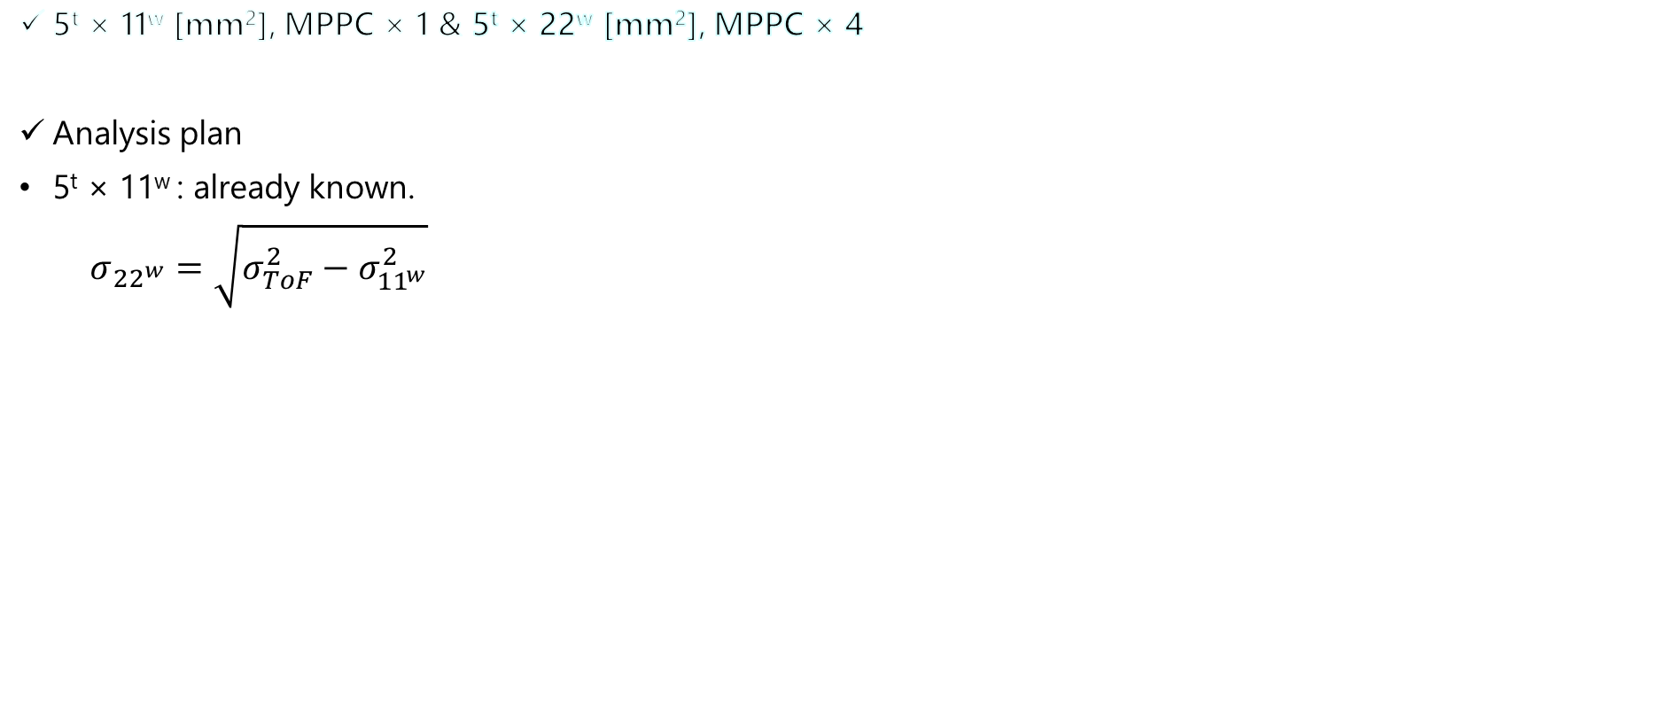
Restart data taking
5^{t} × 11^{w} [mm²], MPPC × 1 & 5^{t} × 22^{w} [mm²], MPPC × 4
Analysis plan
5^{t} × 11^{w} : already known.
$σ_{{22}^{w}}=\sqrt{σ_{ToF}^{2}−σ_{{11}^{w}}^{2}}$
5^{t} × 11^{w} [mm²], MPPC × 1
5^{t} × 22^{w} [mm²], MPPC × 4

Slide 4
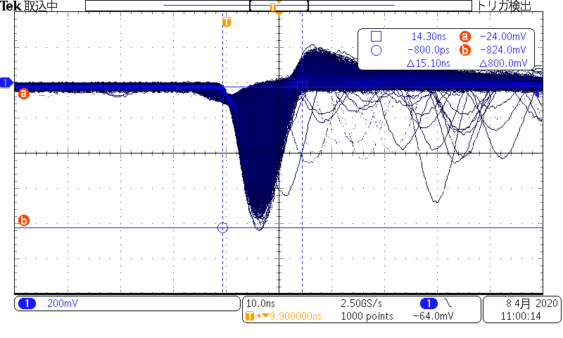
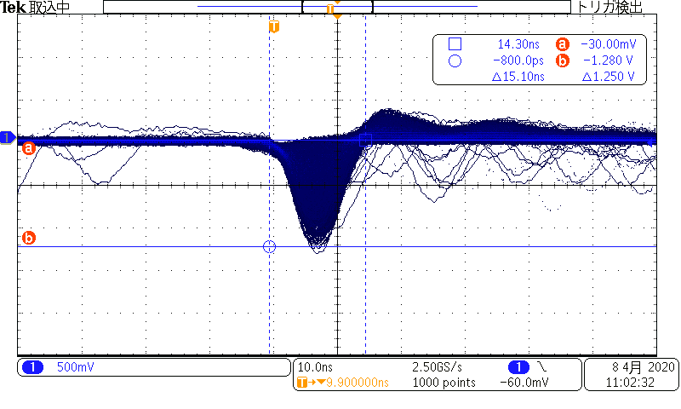
Restart data taking
Signal check. w/ beta-ray source, after PM amp
ToFR: 5^{t} × 11^{w}, MPPC×1
R-1
R-2
10 nsec
10 nsec
200 mV
500 mV
~1250 mV
~800 mV

Slide 5
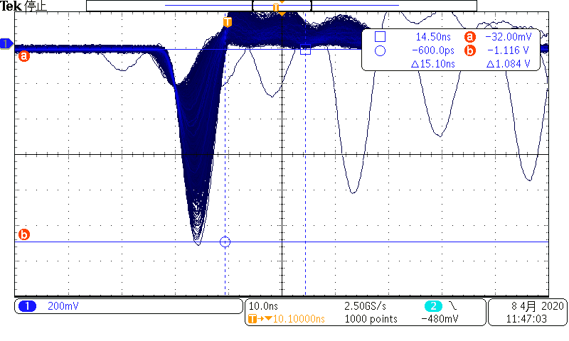
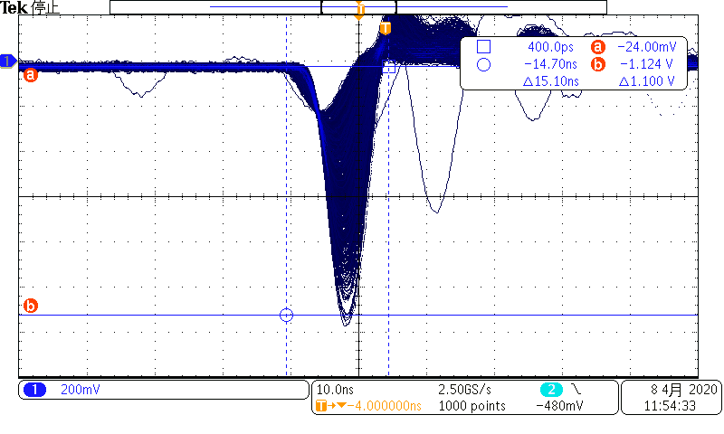
Restart data taking
Signal check. w/ beta-ray source, after PM amp
ToFL: 5^{t} × 22^{w}, MPPC×4
L-1
L-2
10 nsec
200 mV
~1000 mV
~1100 mV
10 nsec
200 mV

Slide 6
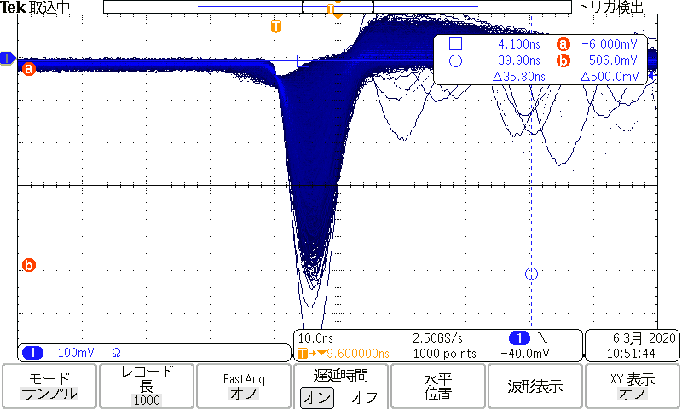
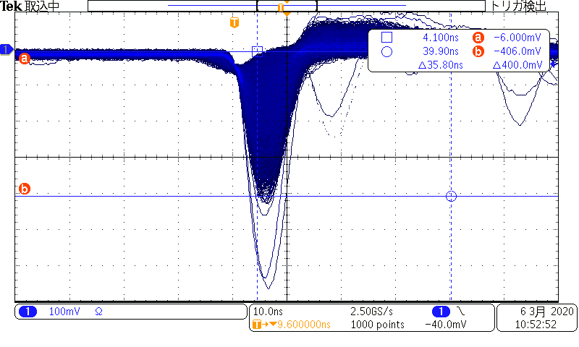
Restart data taking
Signal check. w/ beta-ray source, after PM amp
以前5^{t} × 22^{w}, MPPC×1でデータをとった時の画像
10 nsec
100 mV
~500 mV
~400 mV
10 nsec
100 mV

Slide 7
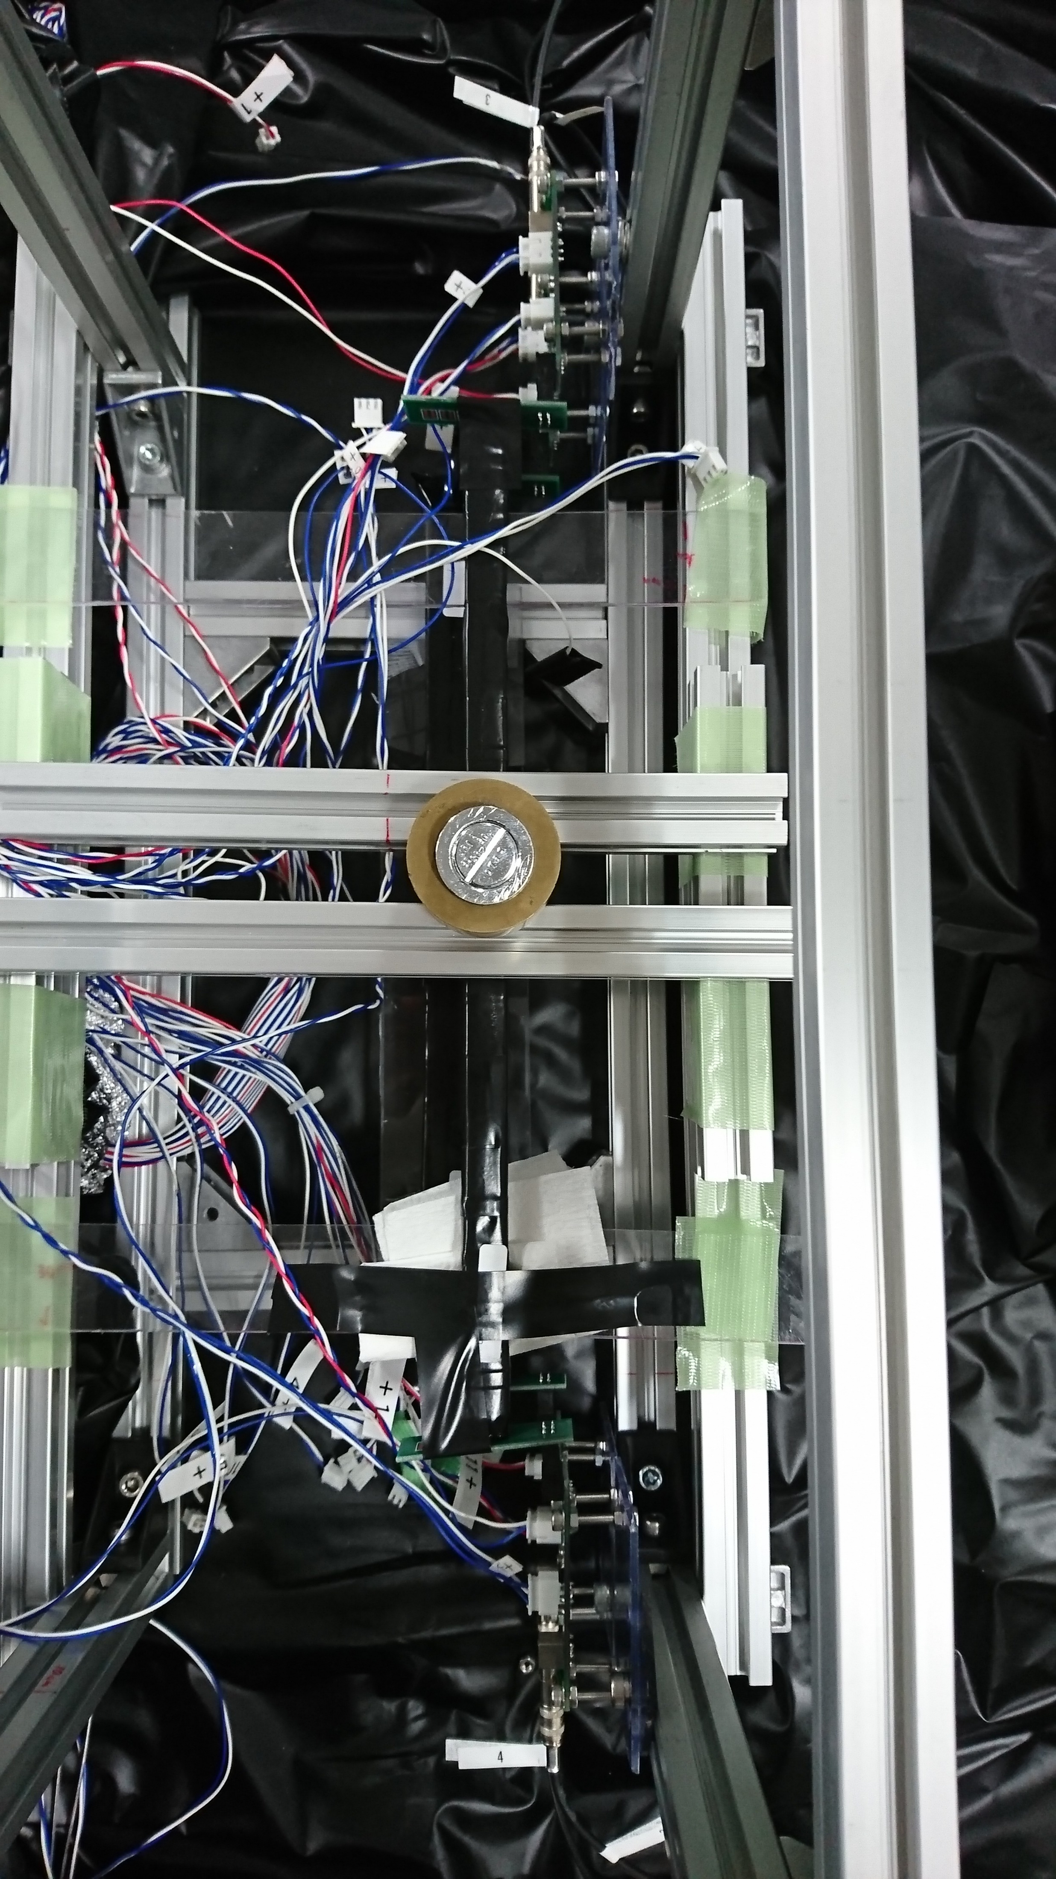
Restart data taking
Data taking w/ beta-ray
w/ collimator
Bias
R->47.7 [V] (fixed)
L->166.8, 178.8, 190.8 [V]

Slide 8
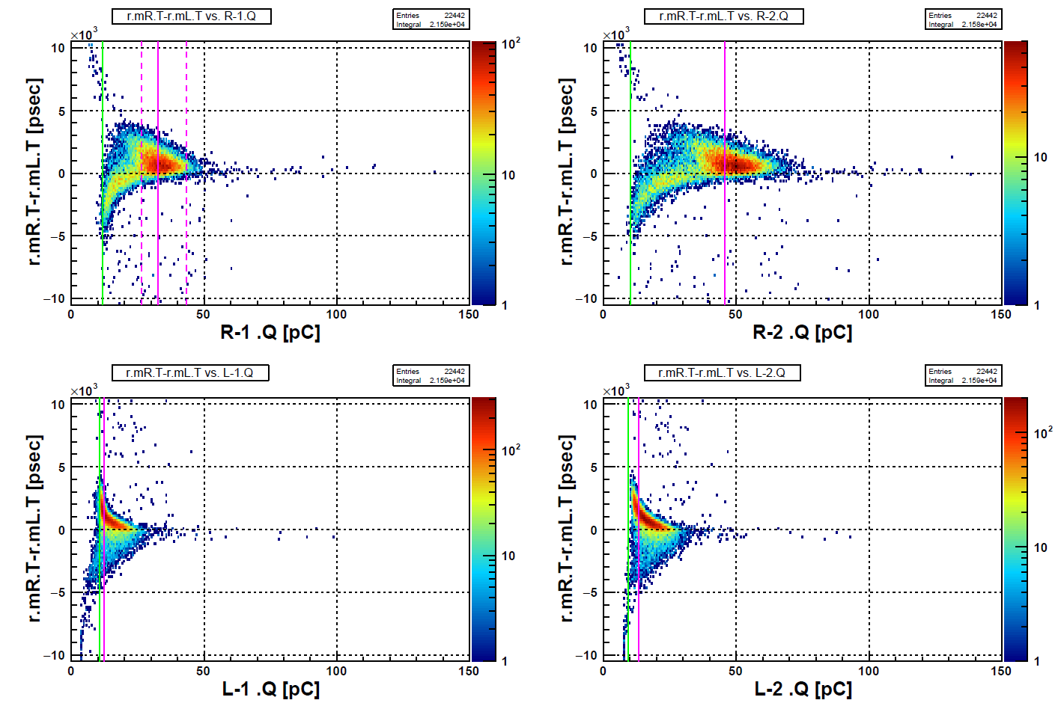
Restart data taking
Result of beta-ray data
ToFL: 178.8 V (44.7V /MPPC)

Slide 9
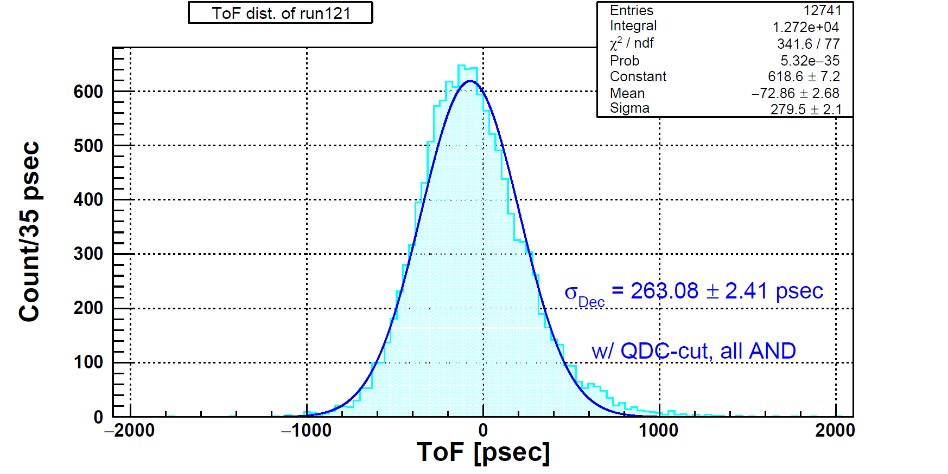
Restart data taking
σ_{ToF} = 279.5 ps
σ_{22w, ×4} = 263.1 ps

Slide 10
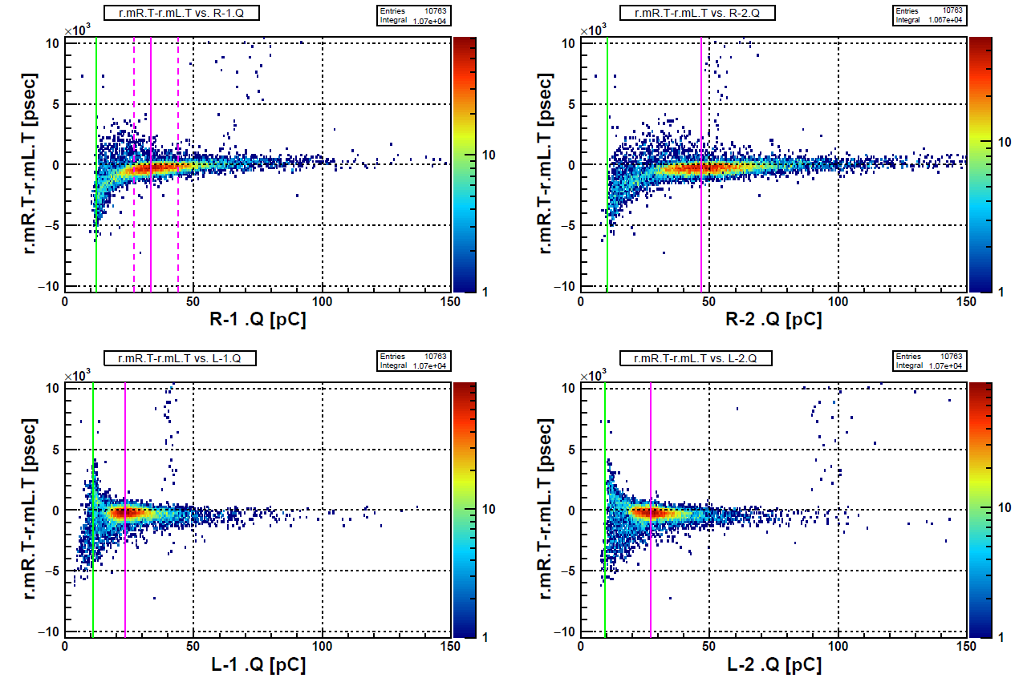
Restart data taking
Data taking w/ cosmic
Bias
R->47.7 [V] (fixed)
L->178.8 [V]

Slide 11
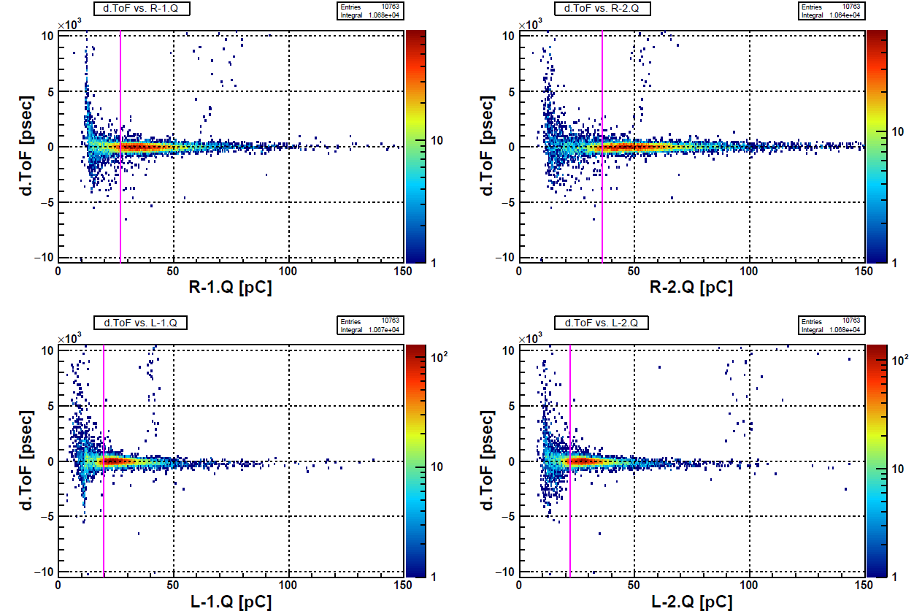
Restart data taking
After time walk correction

Slide 12
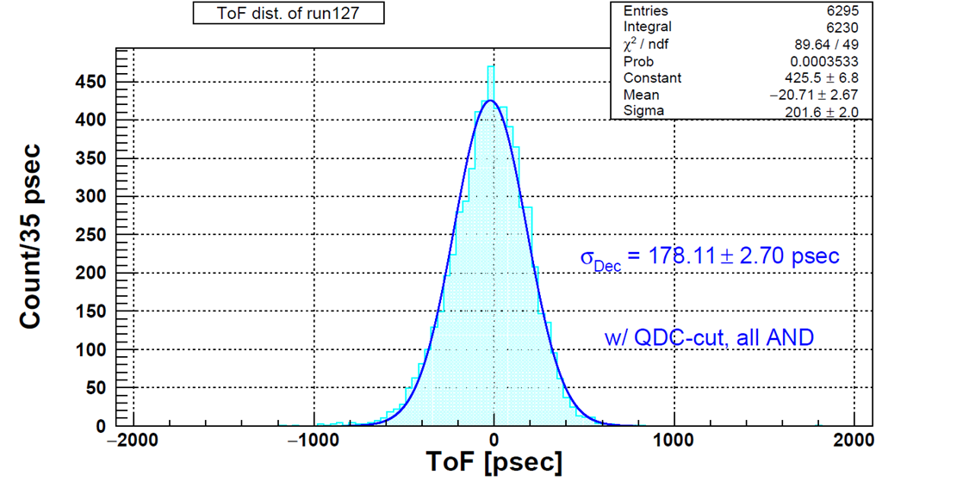
Restart data taking
σ_{ToF} = 201.6 ps
σ_{22w, ×4} = 178.1 ps

Slide 13
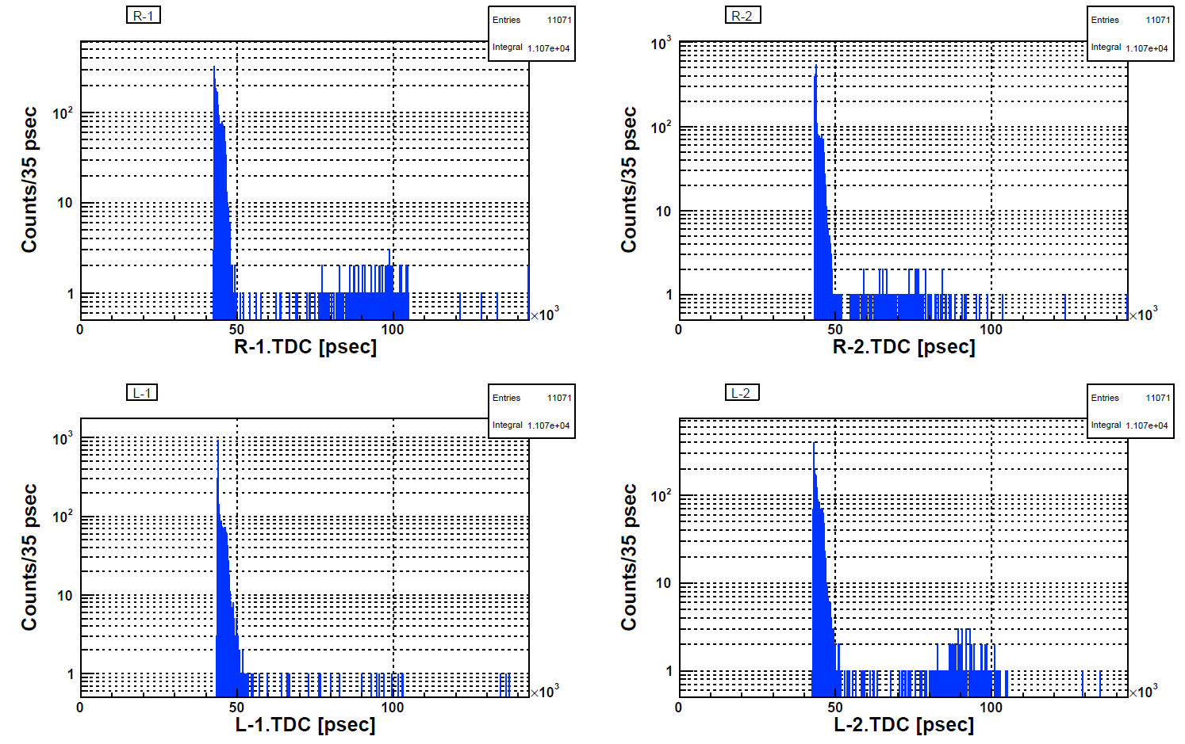
Problem
Request value (R-1⊗R-2⊗L-1⊗L-2) on scaler
数分間程スケーラでの値を見てみたが,
request, accept ともに~7-8 counts/min
今までの宇宙線測定時と同程度
Signal | Val. (2020. 04. 09 17:00時点)
Request | 16609
Accept | 10910
Strange cluster at TDC ~ 2000-3000 ch

Slide 14
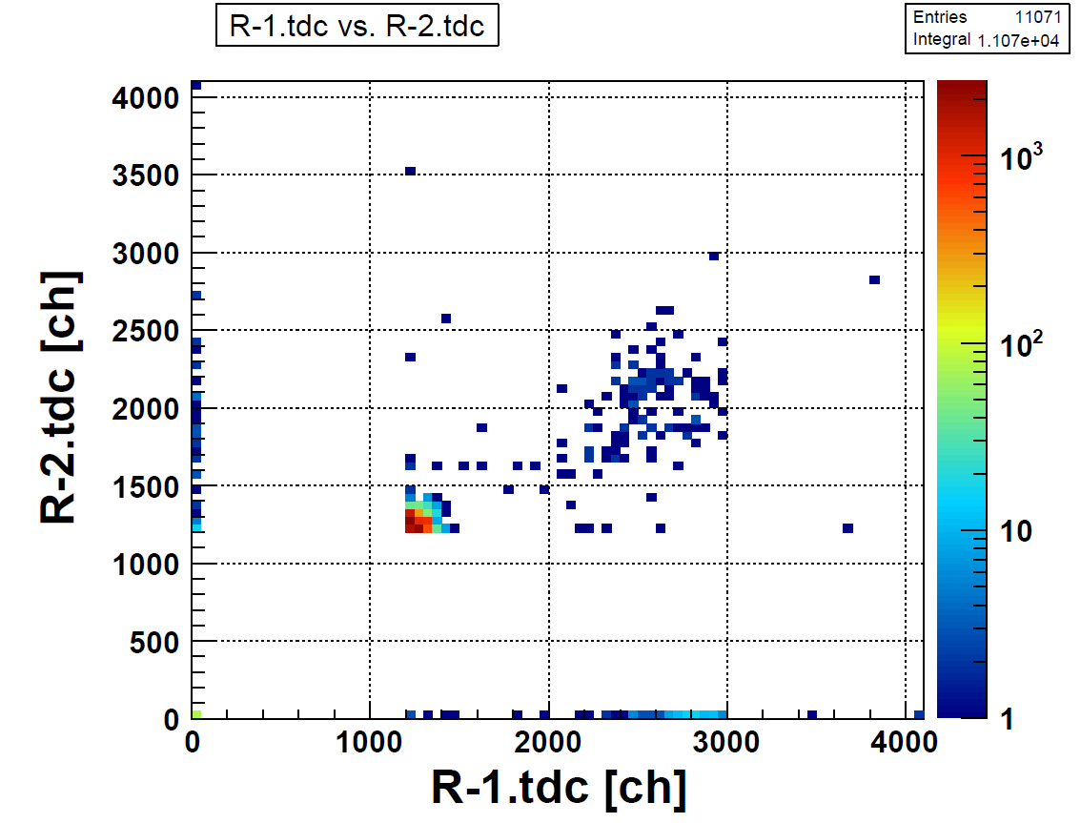
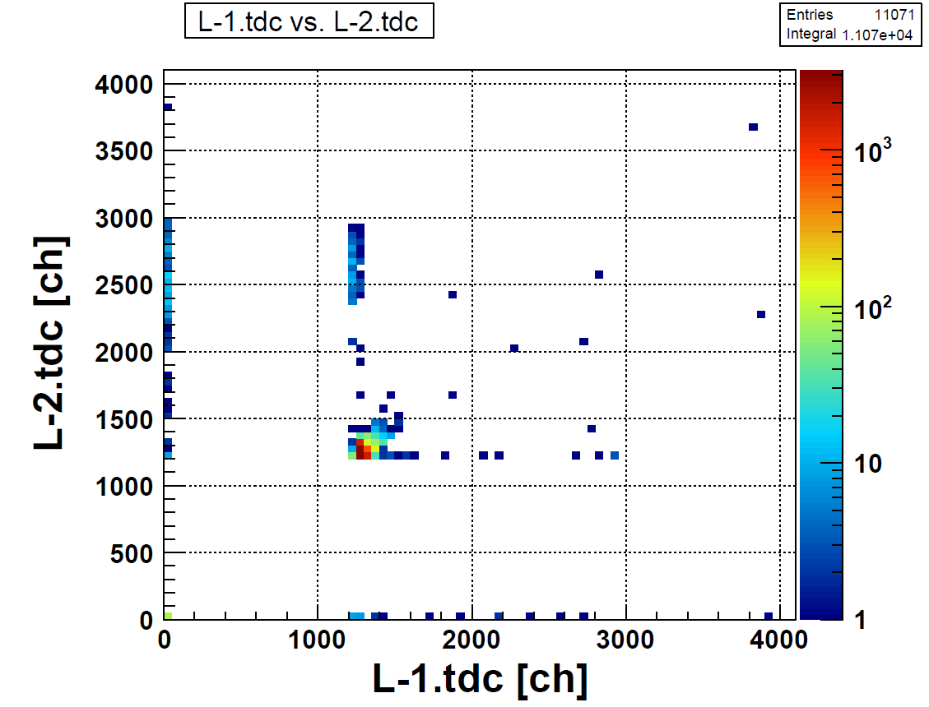

Slide 15
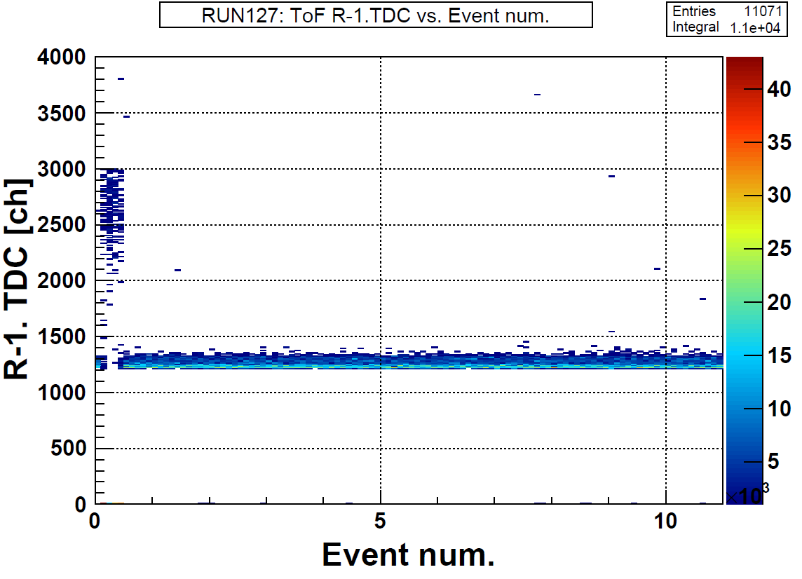
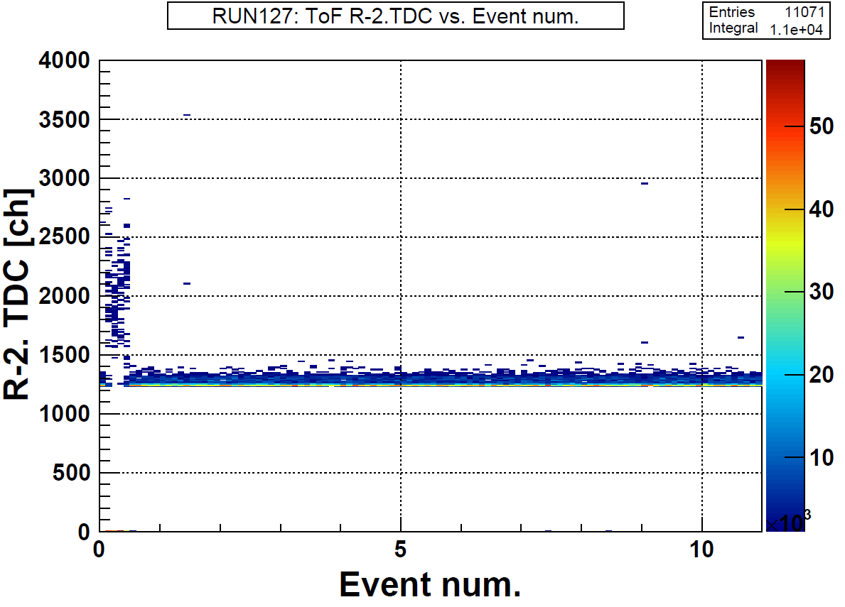
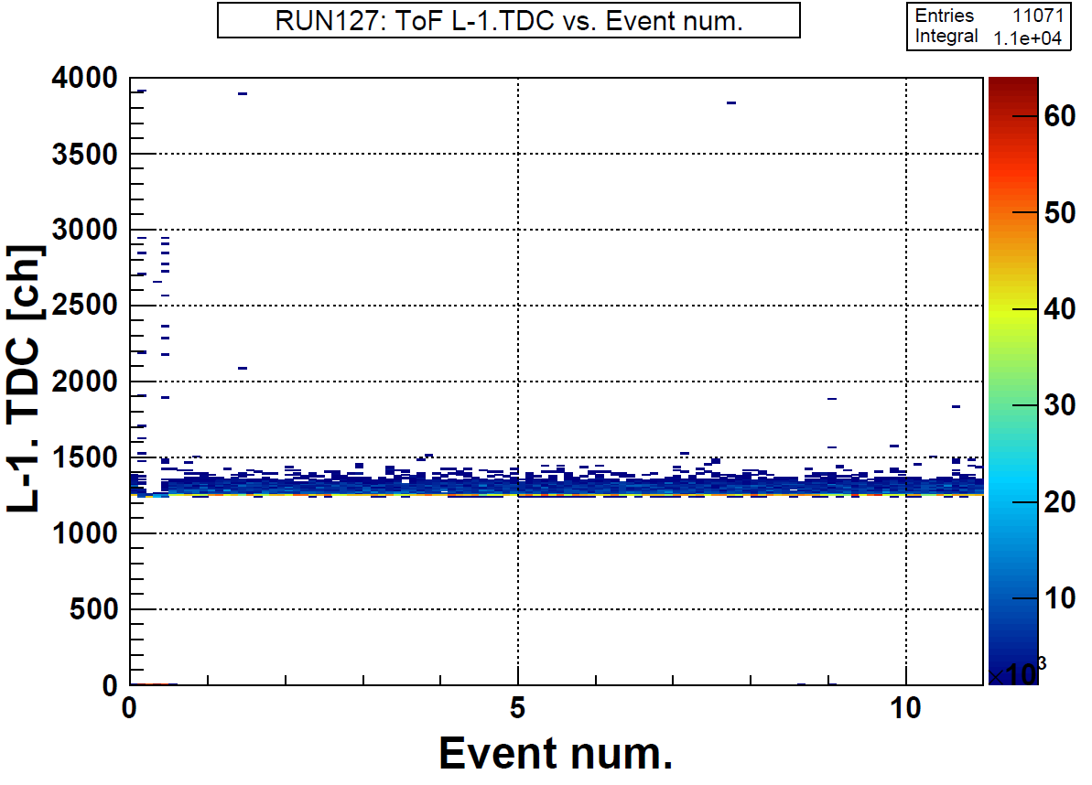
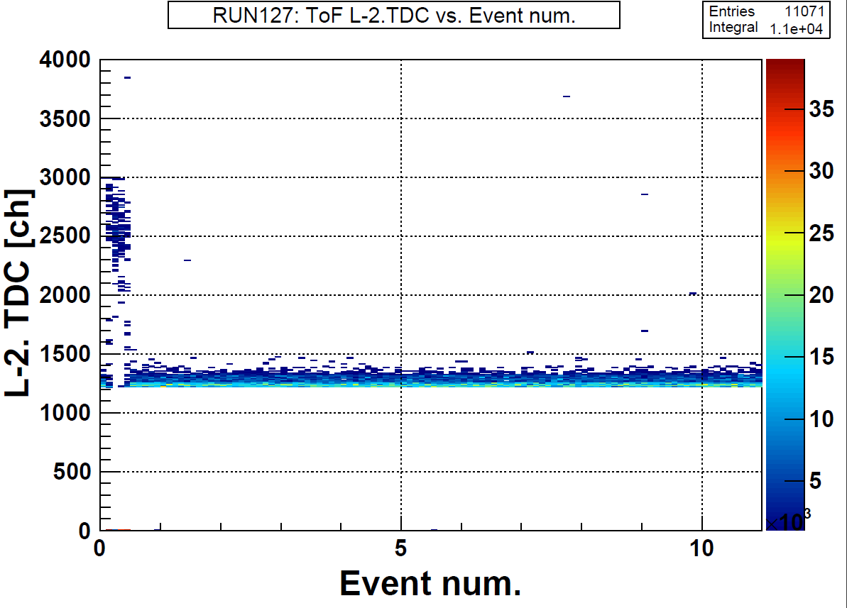

Slide 16
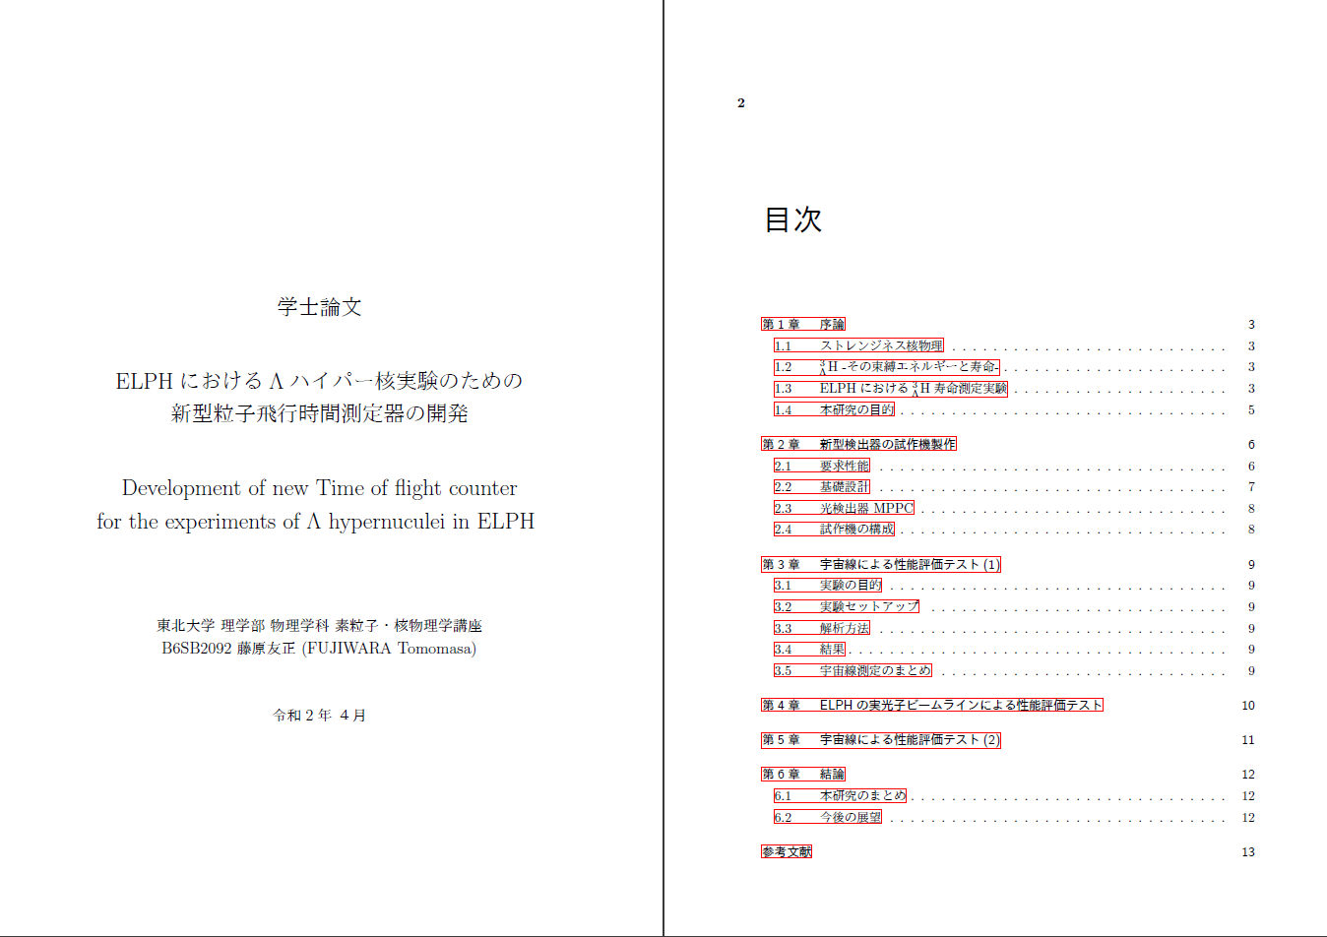

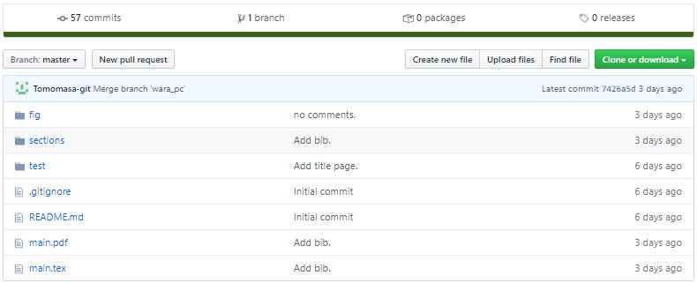
B4 thesis
Little progress
Preliminary
Preliminary
Preliminary
Preliminary
Preliminary
Preliminary

Slide 17
Back up

Slide 20
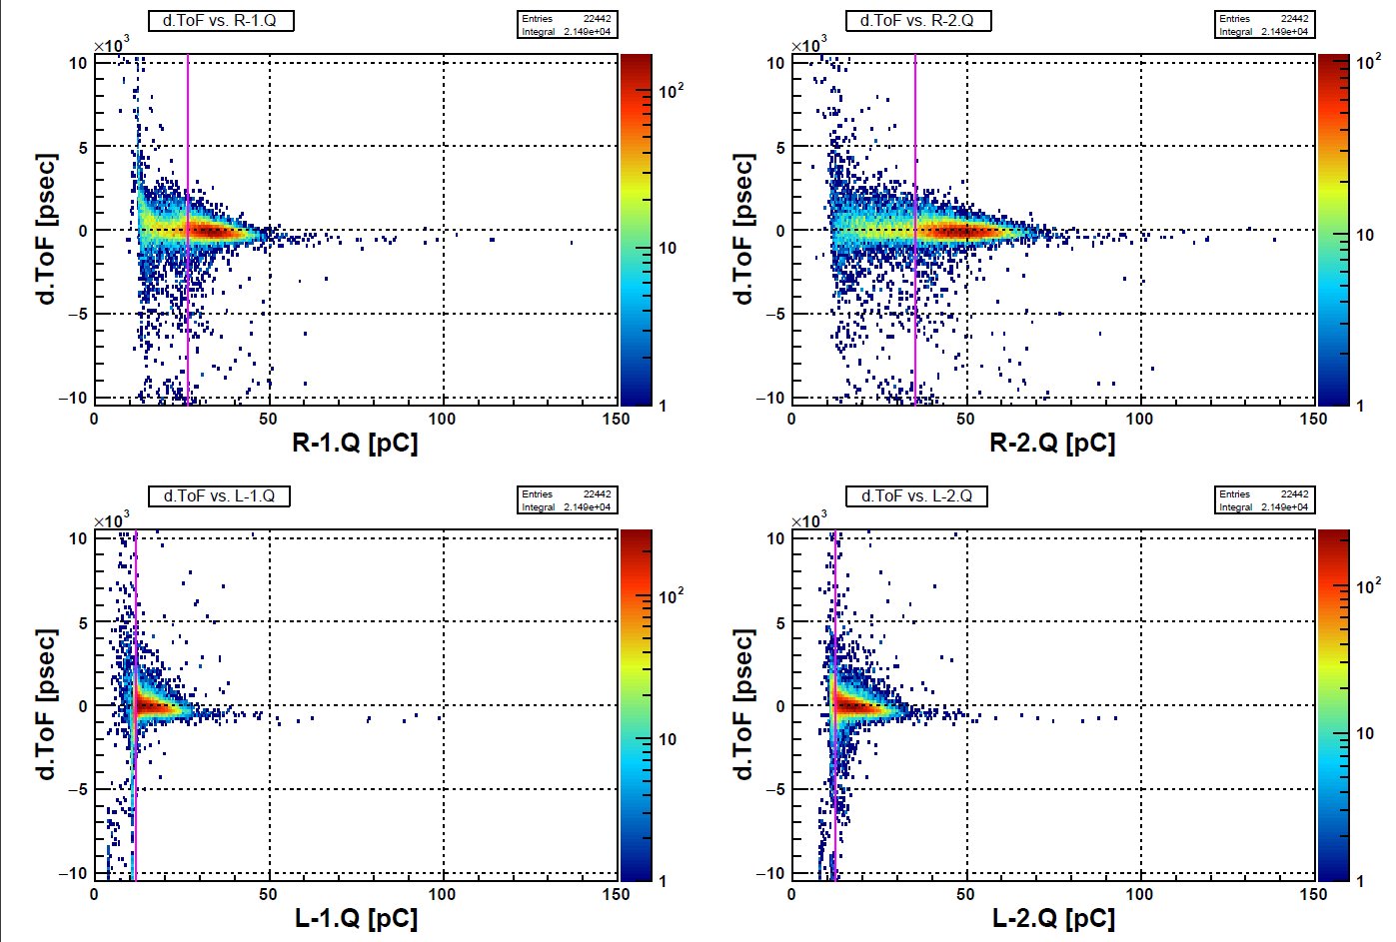

Slide 22
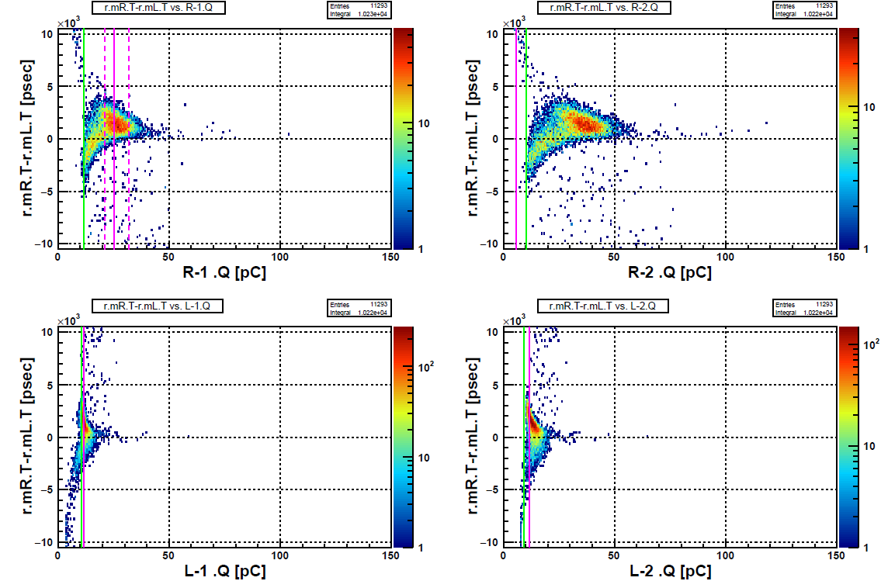

Slide 23
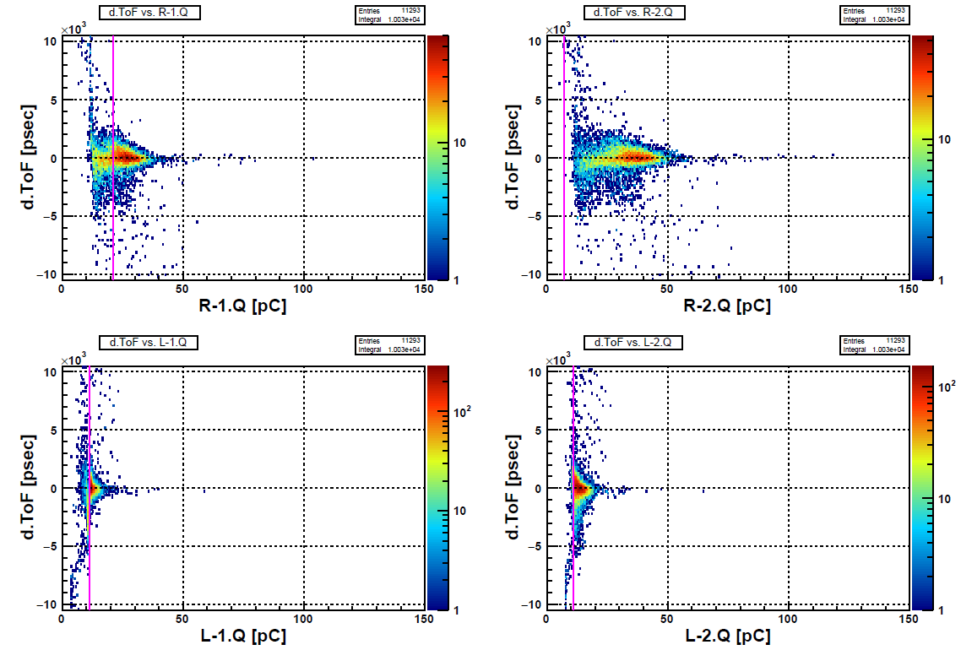

Slide 24
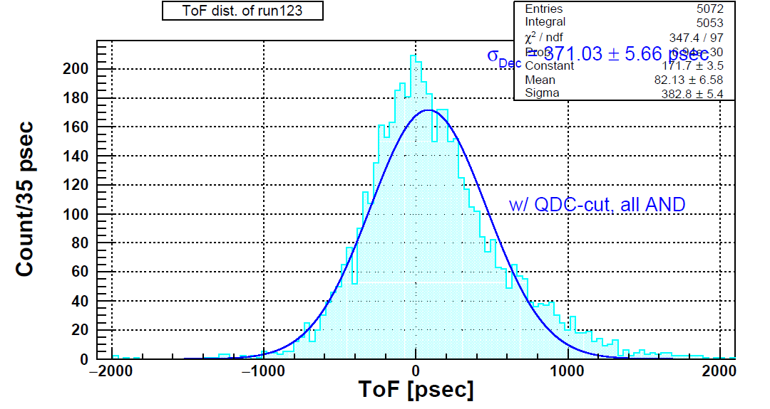

Slide 25
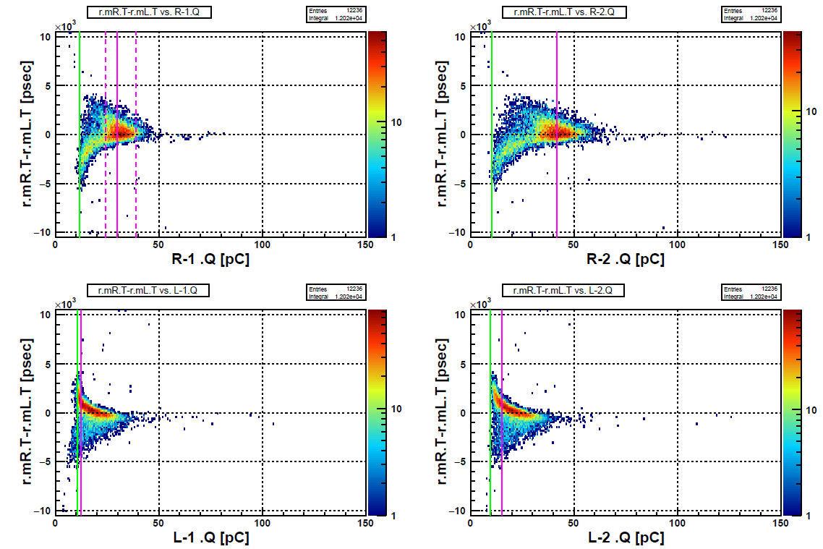

Slide 26
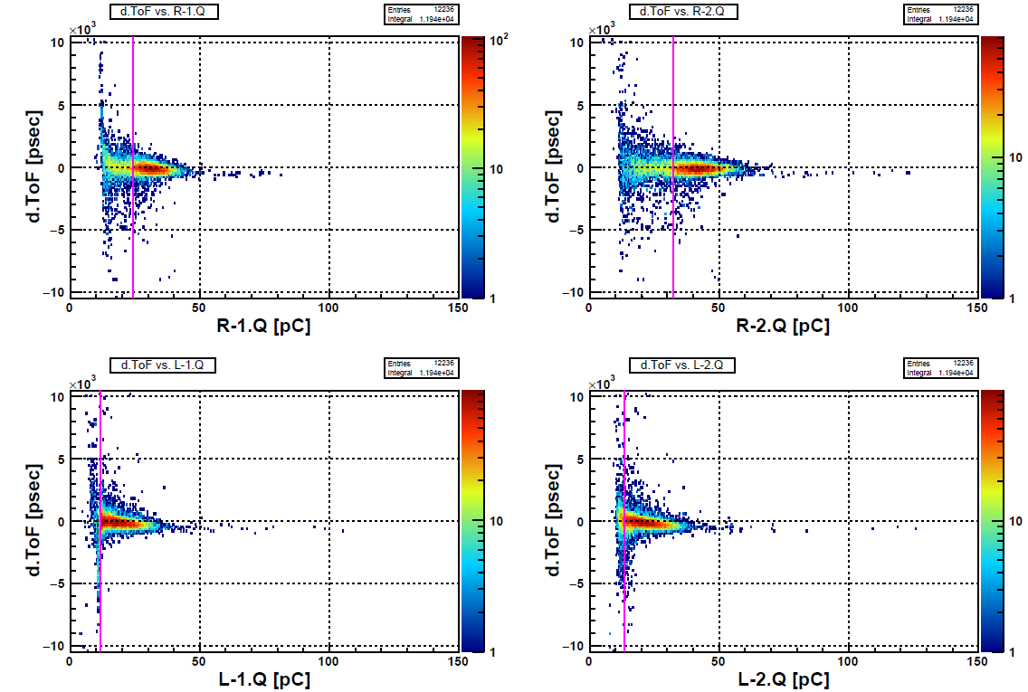

Slide 27
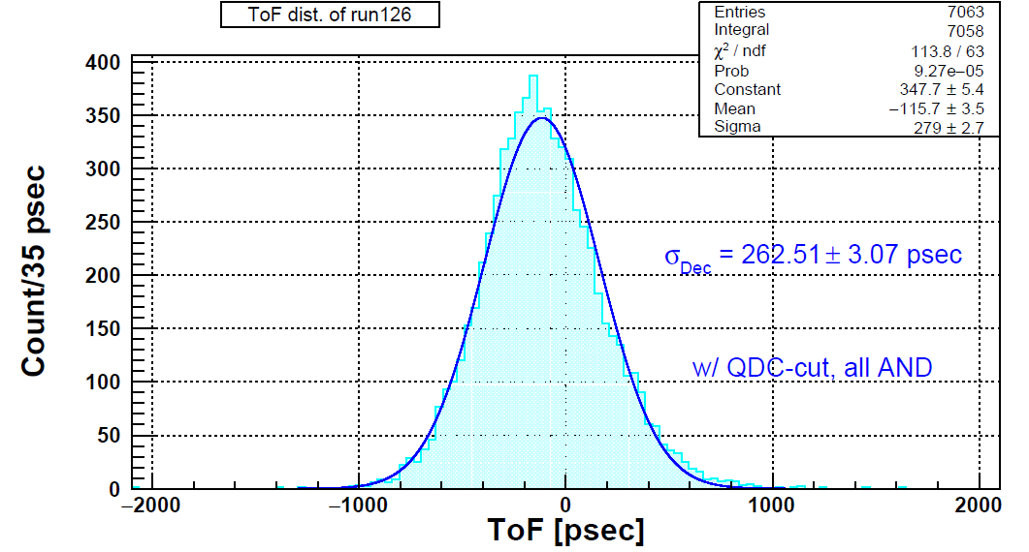

Slide 28
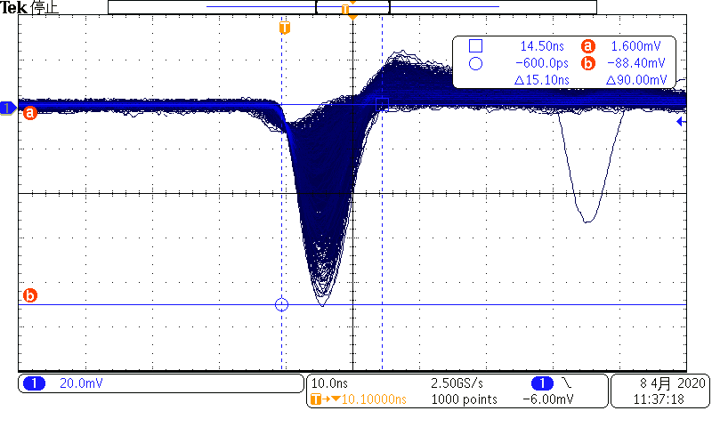
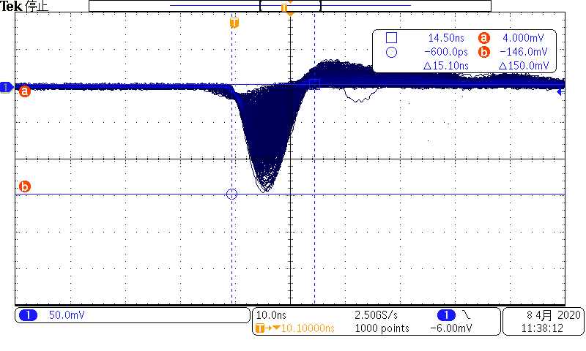
Restart data taking
Signal check. w/ beta-ray source, no PM amp
ToFR: 5^{t} × 22^{w}, MPPC×4
R-1
R-2
10 nsec
20 mV
~90 mV
~150 mV
10 nsec
20 mV

Slide 29

ジワラ
卒論
書く

